Slide 1
Mantid Users Workshop Feedback and Requirements ISIS Muon Group from pre-meeting held 10/1/18
Stephen Cottrell / Anthony Lim

Slide 2
Our Roadmap (2017) …
(only) Seven months on …
June `17: Simultaneous fitting with GUI; Reader for NeXus-v2 muon files
October `17: Freq. domain analysis interface; Plot overlays (within interface); TF data fitting
Later: Correction of PSI background; Data loaders for other (muon) facilities; Muonium chemistry/negative muon analysis; Richer (muon) function library; Double pulse; Revision of analysis interface for Mantid Workbench and to allow unit tests
(done; in process; to do)

Slide 3
Key Issues (2017) …
Stability is a problem … but very important for uptake of software (2018: slight improvement / crash reporting welcomed)
Resources appear a problem … slow progress delivering essential routines (2018: still a problem / evidenced by roadmap)
Beta test time … schedule needs to be sensitive to other demands (too short) (2018: revised schedule welcomed)
Speed of Download … can be very slow (e.g. >1hr EMU last cycle) (2018: now ok)

Slide 4
Other thoughts …
Multiple instances of an interface (2018: very important)
Ability to run an interface alone (2018: still desirable)
Development of fitter … e.g. Poisson statistics (2018: important); Multithreading
Demise of FitWizard (QtiPlot) a concern (could functionality be replicated in new fitting environment?)
Move to Python 3 discussed, reassured by likely introduction during the 2020-21 ISIS long shutdown
Script repository important to muons (Quantum, MuESR, Fit Function Library, other algorithms)
Four muon sources worldwide, Mantid currently used only at ISIS

Slide 5
How Muons are Using Mantid …

Slide 6
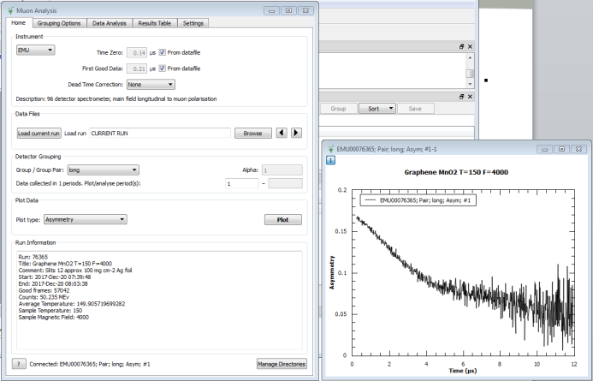
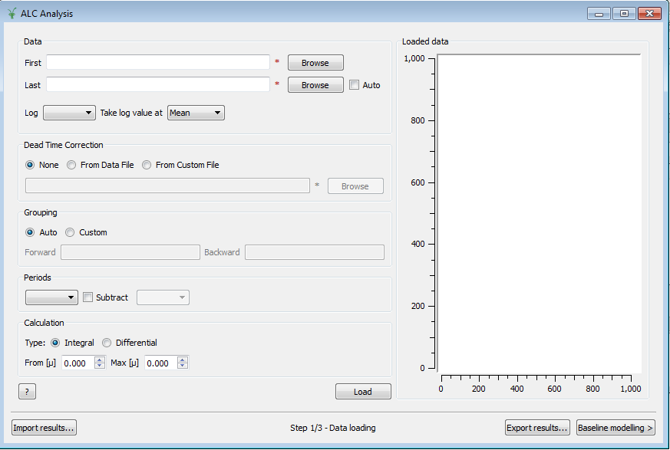
Interfaces are Important …
Mantid seen as a solution for (seamless) data reduction and analysis
Interaction generally through custom interfaces
Time Differential Analysis
Time Integral Analysis

Slide 7
Online Learning for Mantid …
Based on the Moodle Learning Environment…
Introduces the basics of Mantid and the muon interface
Teaches muon data analysis
Muon training materials available at www.e-neutrons.org
Used as part of the biannual ISIS Muon School
Development funded through the EU supported SINE2020 project
Course by Tom Loe and Peter Baker
Based on a workbook by Mark Telling

Slide 8
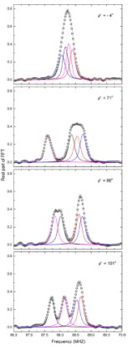
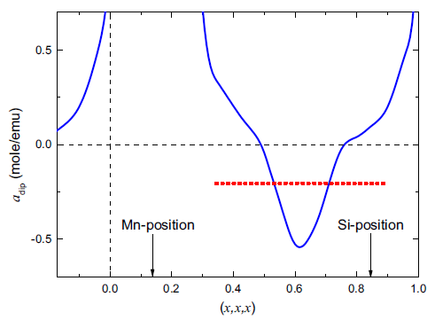
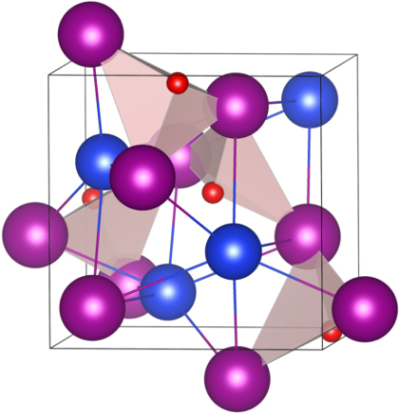
Simulation supporting Analysis …
Knowledge of the muon site often key to detailed interpretation
Calculation package (MuESR) developed to predict muon sites
Python library running under Mantid
Being developed as part of the EU funded SINE2020 project
MnSi;
‘red’ – µ⁺
Measurements
+
Calculations
→
Site prediction / Interpretation
Example from A. Amato et al, PRB 89, 184425 (2014)

Slide 9
Future Requirements … New Instruments are defining New Requirements

Slide 10
SuperMuSR …
Developing project to build SuperMuSR at ISIS …
~1000 detectors (for very high data rates)
Muon pulse slicer (for improved frequency response)
Defines requirements for Reduction and Analysis …
Methods for combining information from multiple detectors (incl. Phase Quad. transform and simultaneous fitting)
Interface for frequency domain analysis (incl. FFT, MaxEnt)
Performance boost through parallel processing (for data fitting)

Slide 11
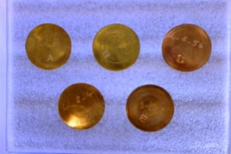
Negative Muons …
Ongoing project to develop negative muon experiments …
Important new tool for elemental analysis
Exploits capability of RIKEN-RAL decay channel
Significant investment in software required to get the best from this new technique:
Requires software for (at least):
Data loader
Background Subtraction
Automatic peak finding/assignment
Absorption corrections
…
Bronze Standards
Sn
Cu
As

Slide 12
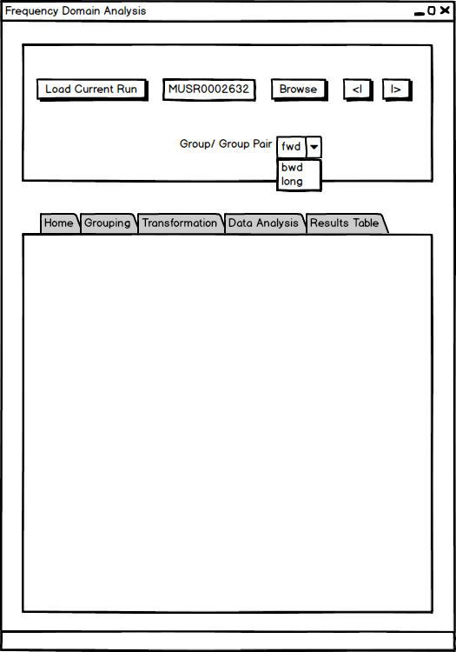
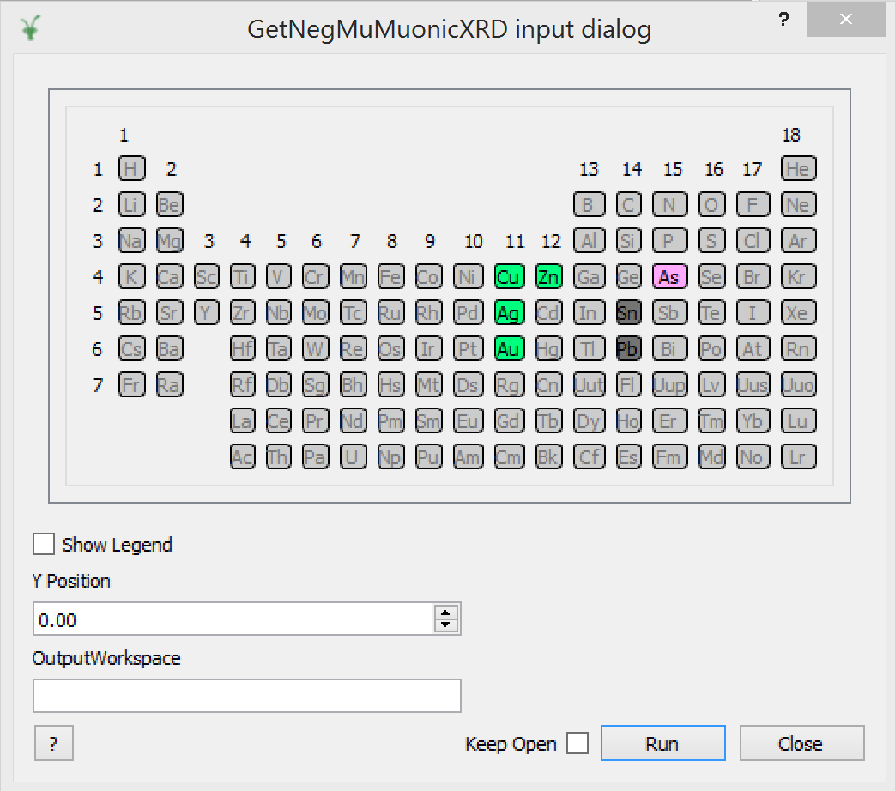
New Interfaces required …
Frequency Domain Analysis …
Complete interface for analysing muon data in frequency domain
Negative Muons …
Periodic Table – clicking on an element generates a table of values of muonic X-ray energies

Slide 13
Parallel Processing for Data Fitting …
Muon data fitting can require relatively large data sets running to hundreds of thousands or even millions of data points
Requires significant performance boost over serial processing
Parallel processing for muon data fitting using graphics card GPUs now demonstrated to good effect in Musrfit and Wimda
GPU speedup in Wimda for moderately
large PSI data sets using ‘consumer level’ NVIDIA GPU card: GTX1060
J. Wilkinson and F.L. Pratt
GPU speedup in Musrfit for very large PSI data sets using ‘research level’ NVIDIA GPU card: Tesla K40
A. Adelmann, U. Locans and A. Suter
Comp. Phys. Comm. 207, 83 (2016)
Data set size | Speedup
~ 50,000 | × 39
~ 100,000 | × 41
Data set size | Speedup
~ 1,300,000 | × 363
~ 3,300,000 | × 446

Slide 14
Our Roadmap (2018) …
March `18: TF data fitting; MaxEnt (v1) in script repository
June`18: Freq. domain analysis interface (FFT, MaxEnt); Double pulse analysis; Richer (muon) function library in script repository; Revision of Time Differential Interface for new Mantid 4 (including unit tests)
Later: Reader for NeXus-v2 muon files; Data loaders for other (muon) facilities; Correction of PSI background; Extension of Freq. domain interface for muonium chemistry; Negative muon analysis (algorithms and interface); Revision of analysis interface to allow unit tests; Plot overlays (within interface); Functions for modelling fitted data

